Slide 1
Sorting Algorithm Comparison
30032159
8/23/2021

Slide 2
Testing Methodology
Generate random values using “Random” class
Initialize 3 timers
Start timer T, do a sort
Stop timer T
Do this for all 3 sorting methods and timers
Append time taken to sort on a CSV string
Output CSV strings to file when finished all tests

Slide 3

Quick Sort
Splits the array into two sub-arrays and sorts them based on whether they are greater or smaller than the “pivot” value.
Big O (average) of O($n^{2}$)
Big O (worst) of O(n log n)
Not stable

Slide 4
Heap Sort
Stores unsorted values in a “heap” to help find largest value faster.
Big O (average) of O(n log n)
Big O (worst) of O(n log n)
Not stable

Slide 5
Intro Sort
Starts with quicksort, switches to insertion sort/heapsort
Big O (average) of O(n log n)
Big O (worst) of O(n log n)
Not stable

Slide 6
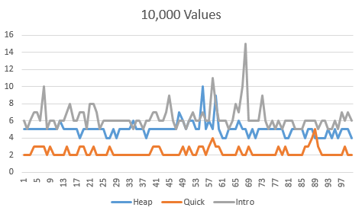
Data – 10,000

Slide 7
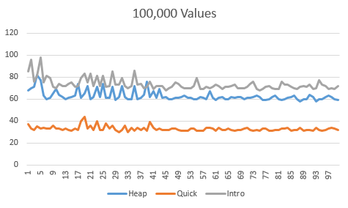
Data – 100,000

Slide 8
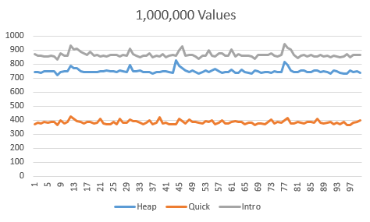
Data – 1,000,000

